Slide 1




Our Vision Provide field training and training support that makes a lasting difference
Our Mission
Make great maintainers even better
& communicators
^
Notes:
FTD’s mission is not to create the new maintainers…that falls to the 82d & 782d Training Groups…FTD’s mission is to take already great maintainers and make them even better!

Slide 2
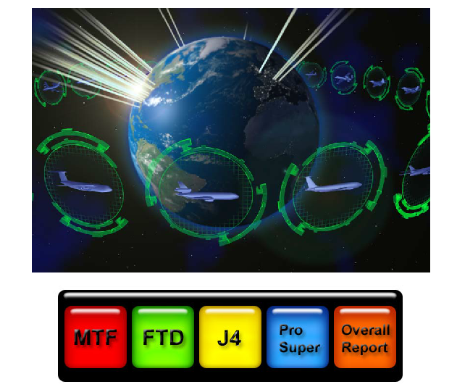
FTD FTSS Interface
Field Training Detachment
Field Training Scheduling System Interface
POCs:
Capt Madison Gilbert
SSgt Cody Pratt
Last Updated 16 July 2013
FOR OFFICIAL USE ONLY

Slide 3
FTD FTSS Interface
The FTD Interface enables FTD to answer MTF’s electronic 898 requests, and also allows for seamless uploading and downloading of scheduling and production information to and from FTSS.
The electronic 898 process fulfills all AFI requirements and enables the requests to be completed digitally.
FTD schedulers, production supervisors, and leadership should download the frontend to their desktop for use.
If any program changes are made after the testing period, a new Frontend and Backend version will need to be downloaded by the FTD users.

Slide 4

FTD FTSS Interface
Overview
Access (FOR ALL USERS, Slide 5)
Initial Programming (FOR DATABASE MANAGER ONLY, Slides 6-26)
Initial Programming (FOR ALL USERS, Slides 28-30)
User Functions (FOR ALL USERS, Slides 31-38)
Electronic 898 Responses (FOR SCHEDULERS ONLY, Slides 39-42)
Additional Features (FOR SCHEDULERS ONLY, Slides 43-50)
Summary/Contact Information (Slide 51)
These are hyperlinked to take you to the correct slide….if you are not a scheduler or DB Manager, only follow the “For All Users” slides!

Slide 5
Users: FTD FTSS Interface Access
For Access:
Ensure you have access to FTSS: https://app-eis.aetc.af.mil/amt/default.aspx
If you do not, you will need to send an email to 982TRG_CCK@sheppard.af.mil requesting access to FTSS. Include that you are a FTD Scheduler and need access to the FTD/ProSuper tabs.
If you are still having trouble, feel free to contact Capt Gilbert at DSN 682-8150 for additional help.

Slide 6
DB Manager: Initial Programming
1. Initial Programming
To be accomplished by the Database Manager (pick one person to set up the Interface, who will, from now on, be named the Database Manager)
SKIP THIS SECTION IF YOU ARE NOT THE DATABASE MANAGER

Slide 7
DB Manager: Initial Programming
The FTD FTSS Interface is a split access database system, where the frontend interface is downloaded to each individual’s desktop (to make it run faster), and the backend--where all the data is stored--is placed in a central location (a shared drive). This requires you, the database manager, to link the frontend interface to the backend data.
The best approach is for the database manager to perform the linking of the system, then place the frontend in a central location for all users to download.
See below and next slides for detailed installation instructions.
STEP 1: Open the following site: https://sheppard.eis.aetc.af.mil/982TRG/dtms/FTD%20FTSS%20Interace/Forms/AllItems.aspx

Slide 8
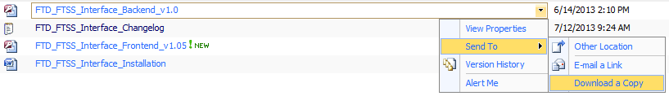
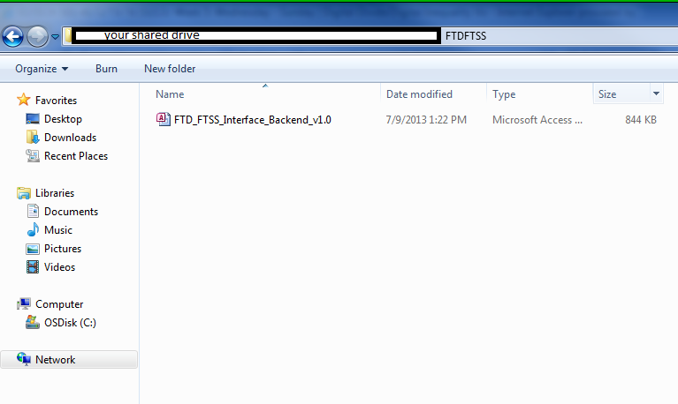
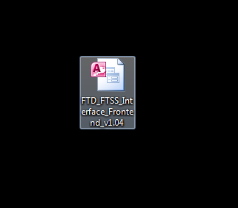
DB Manager: Initial Programming
Step 2: Download FTD FTSS Interface Backend File to the Detachment’s Shared Drive and the FTD FTSS Frontend to your desktop. You can download the items by clicking down arrow, “Send To”, “Download a Copy”.
How to Download from site
Download Backend to Shared Drive
(Computer Desktop)
Download Frontend to Computer Desktop

Slide 9
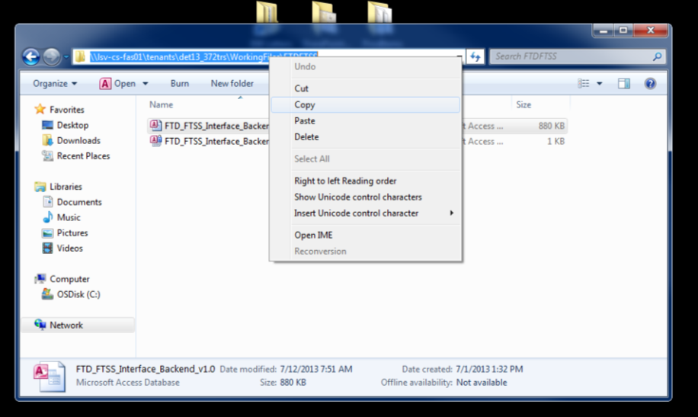
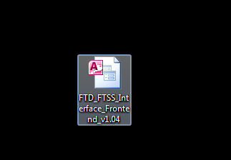
DB Manager: Initial Programming
Step 3: Copy the Shared Drive Location Link that holds the FTD FTSS Interface Backend.
Step 4: Hold the SHIFT key while opening the FTD FTSS Interface Frontend on your computer desktop.
3. Copy Shared Drive Link
(Computer Desktop)
4. Hold SHIFT and double click the Frontend on your Desktop

Slide 10
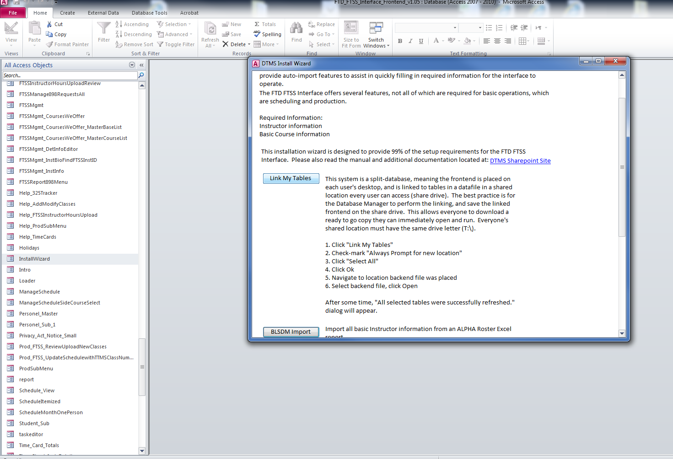
DB Manager: Initial Programming
Step 5: Use the Installation Wizard to link the frontend to the backend by clicking InstallWizard and Link My Tables.
5. Click InstallWizard (a pop-up window will appear) and then click Link My Tables

Slide 11
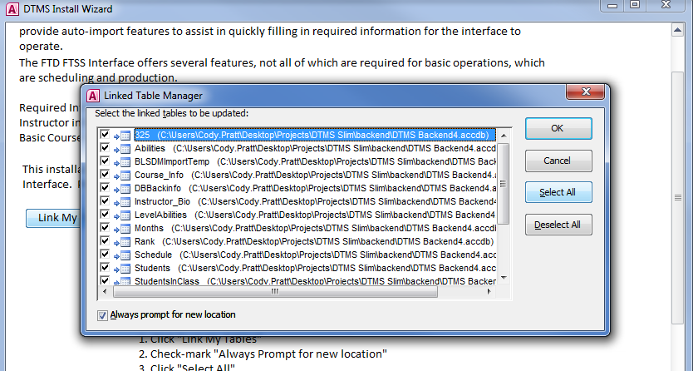
DB Manager: Initial Programming
Step 6: Check “Always Prompt for New Location” and then click “Select All” and “OK”.
6. Check “Always Prompt for New Location”, click Select All, and click OK

Slide 12
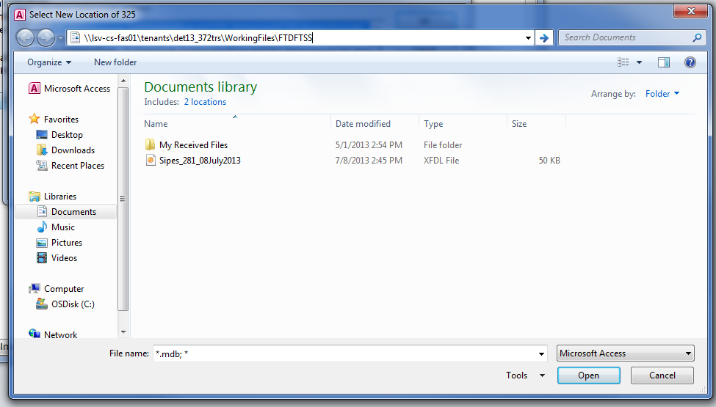
DB Manager: Initial Programming
Step 7: Copy Backend Location Link and paste into the URL. Click the Backend file and click Open.
7. Copy Location of Backend link, paste into Pop-up Window, select Backend icon, and click Open

Slide 13
DB Manager: Initial Programming
Step 8: Copy Backend Location Link and paste into the URL. Select the Backend file and click Open.
NOTE: May take up to 5 minutes to link tables after you press OK!
8. Copy Location of Backend link, paste into Pop-up Window, select Backend icon, and click Open…could take up to 5 minutes to link the tables!

Slide 14
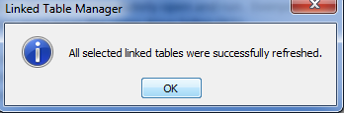
DB Manager: Initial Programming
Step 9: You may now press OK, send the Frontend link to the schedulers/prosuper/leadership in your det, and close out of the program.
9. Press OK and close out of the program….You are now ready to send the link to applicable detachment members to use!
THIS IS THE END OF THE INSTALLATION PROCESS.
The next slides will show you information for the Database Manager inside the FTD Frontend Interface

Slide 15
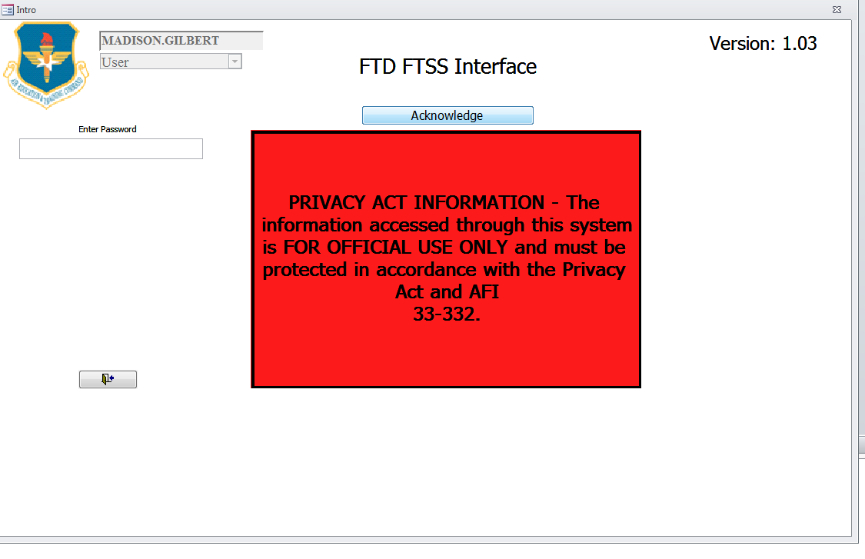
DB Manager: Access Interface
(Computer Desktop)
Click on the FTD FTSS Interface Frontend icon on your desktop. When the Interface opens, acknowledge the Privacy Act Information statement.

Slide 16
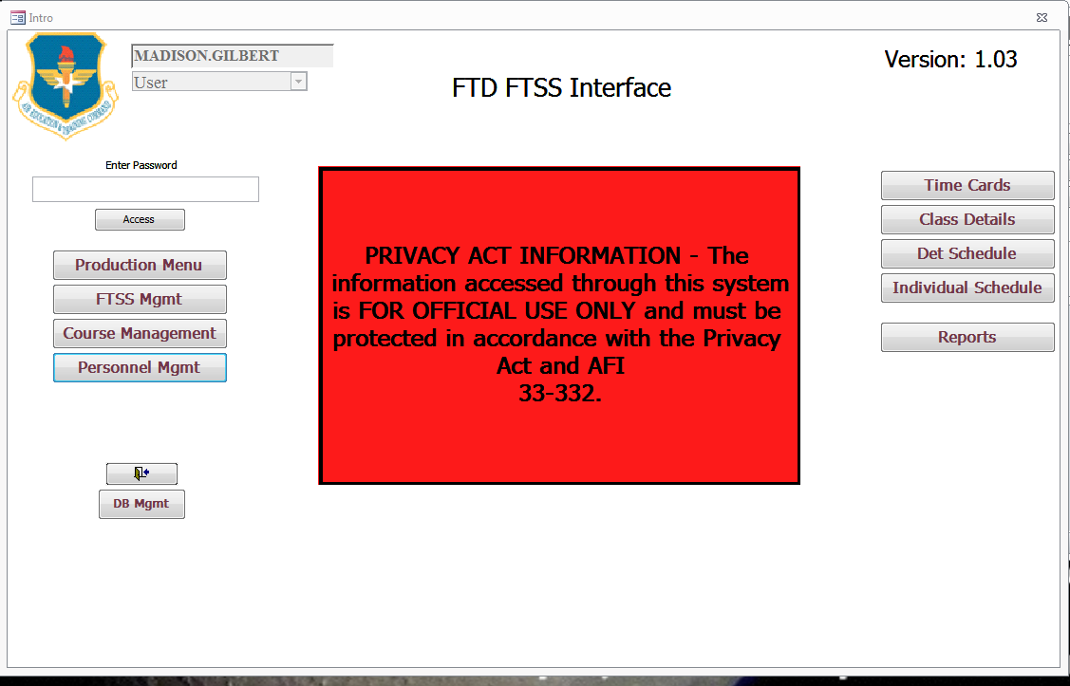
DB Manager: Access Interface
Enter the password “DET” to see the information on the left-hand side (you can change the password later)
If you are the Database Manager, start by entering DB Mgmt. DB Mgmt allows for editing and manipulation of information affecting items database-wide, namely what shows on reports.

Slide 17
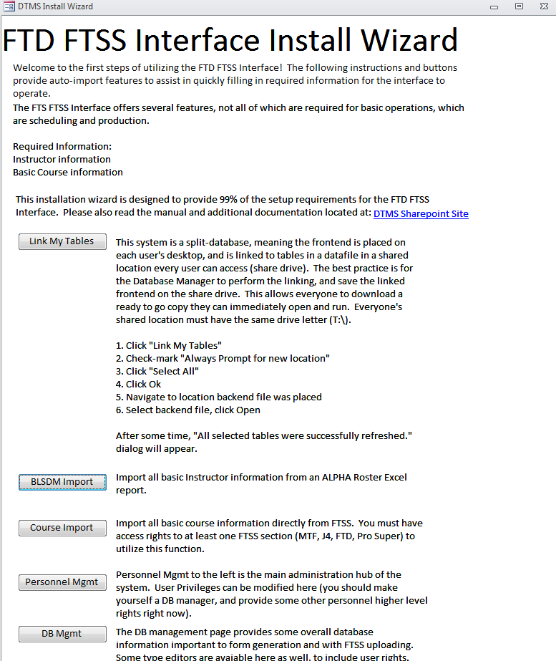
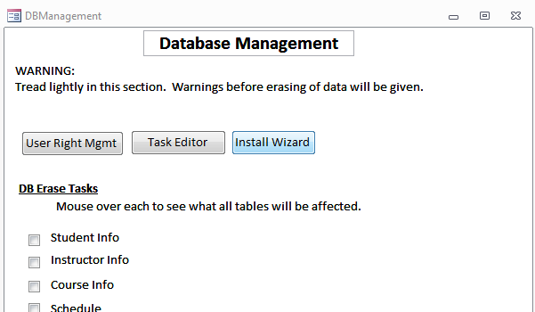
DB Manager: Interface Setup
Start by clicking on Install Wizard. Install Wizard is designed to provide the setup requirements for this Frontend. Follow the directions provided (Note: you have already completed the “Link My Tables” task in the installation procedures).

Slide 18
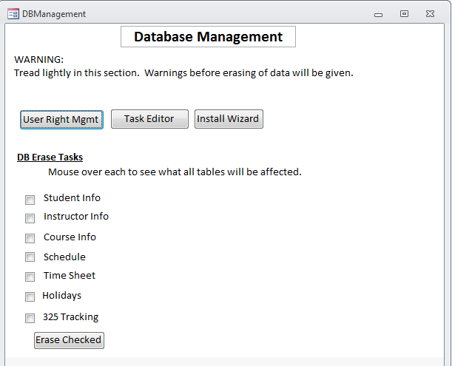
DB Manager: Interface Setup
Click on User Right Mgmt to set up passwords for each User Type, as well as what is viewable to that user type. User types include: User, Production, ISD, PTL, DB Manager, ISD&PTL, and Prod&PTL.
Click on Task Editor to revise/change Det tasks for instructor timecards (ie MTT hrs, Add Duty hrs, etc). It also gives you an explanation of each Task. Delete with caution!
Check any box to delete all data in these fields. Click Erase Checked to delete all data. Delete with caution!

Slide 19
DB Manager: Interface Setup
Next, view the Personnel Mgmt button to ensure all instructors are loaded into FTSS.
NOTE: All Det personnel will be viewable here if the ALPHA roster was correctly uploaded (see slide 17).

Slide 20
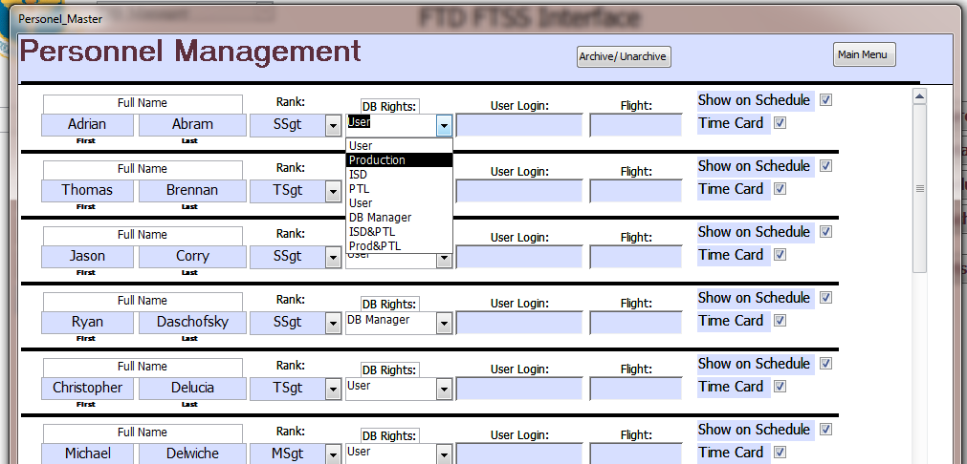
DB Manager: Interface Setup
You can give certain rights to each individual in the detachment so that they do not need to use a password when logging in (i.e. Production will automatically see the Production Menu on the Main Page).

Slide 21
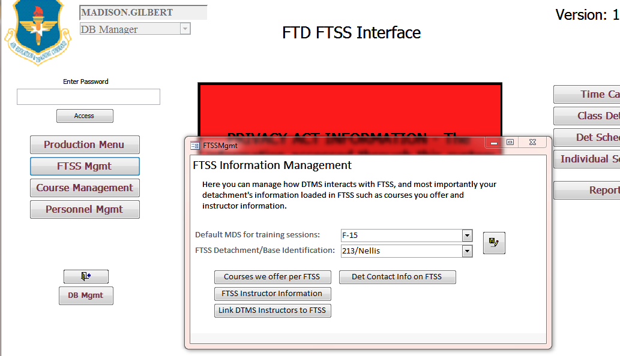
DB Manager: Interface Setup
Next, view the FTSS Mgmt button to ensure this interface is properly communicating with FTSS (if asked for your digital certificates, click the Email CAC button).
The default MDS should be selected for what the majority of training sessions will be at that detachment. Also input your detachment from the drop down menu. Press the save button.

Slide 22
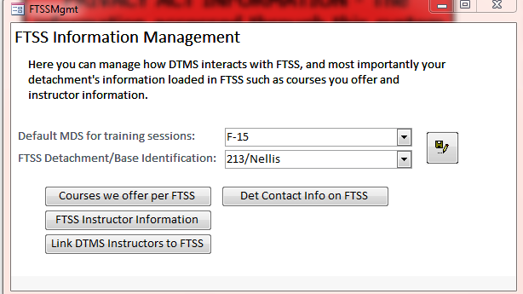
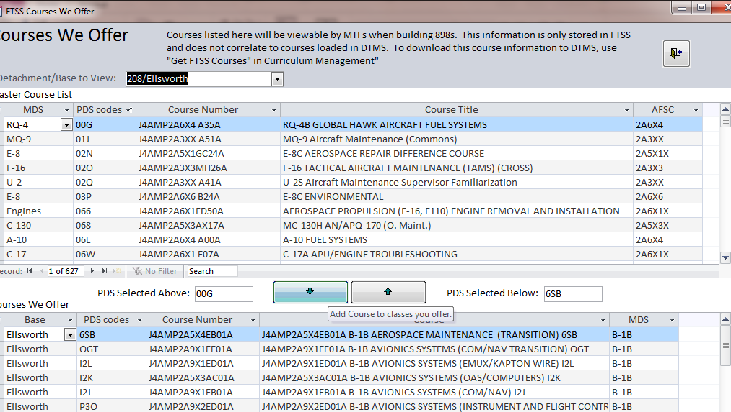
DB Manager: Interface Setup
The “Courses We Offer Per FTSS” button is *CRITICAL* to enabling MTFs to view and make requests for courses taught at your detachment.
Select your Det and then add all offered courses to your list. Anytime your detachment begins or stops teaching a course, you will need to update your course listing here (so that MTF can/cannot request that course on their Form 898s).

Slide 23
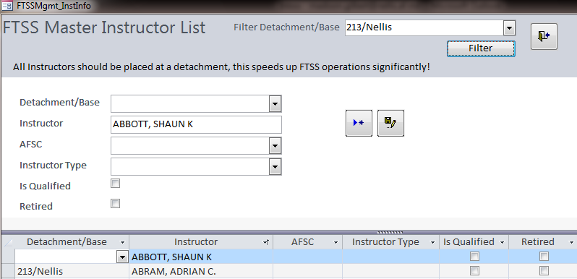
DB Manager: Interface Setup
The “FTSS Instructor Information” button allows you to update instructor information viewed in FTSS by leadership. This ONLY updates information in FTSS and not instructor information on this interface.
A list of all instructors in FTSS will appear. When you find an instructor who belongs to your base, add the applicable information (Retired means no longer teaching). You can ensure all your instructors are listed by clicking the “Filter” button and reviewing.

Slide 24
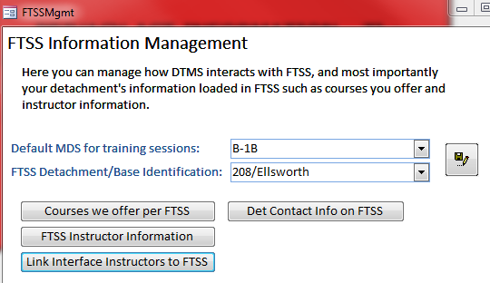
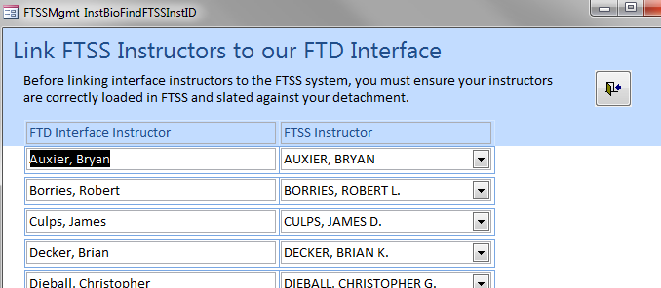
DB Manager: Interface Setup
The “Link Interface Instructors to FTSS” button allows you to link the local database instructors to FTSS. This is needed for uploading production metrics for each instructor at the end of every month.
A list of all instructors in FTSS in your detachment and all in the FTD FTSS interface will appear. Update to ensure all names here are the same on each row.

Slide 25
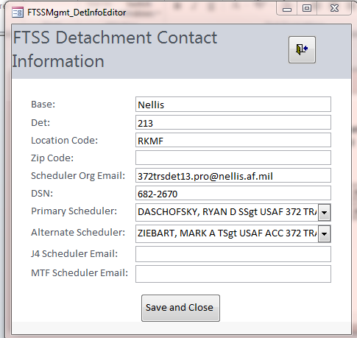
DB Manager: Interface Setup
The “Det Contact Info on FTSS” button enables you to view your scheduler(s)’s information, as well as org boxes/phone numbers/etc.
If your schedulers’ names are incorrect, contact the J4 Schedulers at Sheppard. They can change this information. (You will not be able to).

Slide 26
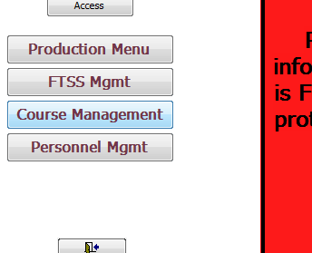
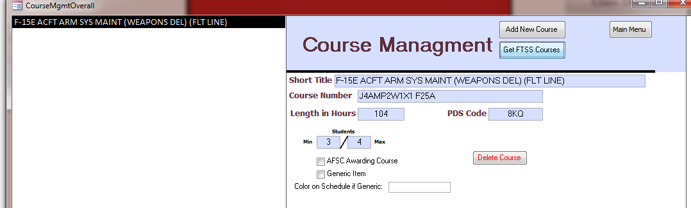
DB Manager: Interface Setup
The “Course Management” button on the front page can be filled out by any CCD monitor, Production member, Database Manager…basically, anyone who knows what courses are taught by the detachment. Please give them these instructions.
To get your courses from FTSS, click “Get FTSS Courses” and see next slide.

Slide 27
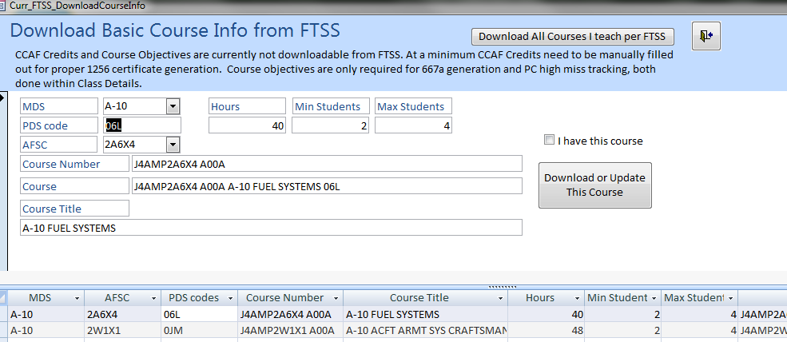
DB Manager: Interface Setup
If you just filled out on FTSS courses that you offer at your detachment under the FTSS Mgmt menu, then you can now automatically download all courses FTSS sees that your detachment offers by using this button.
Pick the course you offer at your det, and click “Download or Update This Course”. Do this for all your courses. You do not need to exit out…once you click “Download or Update This Course”, your course will be downloaded and you may continue downloading more courses.

Slide 28
Users: Interface Setup
2. Installation Instructions for Users
Once the Database Manager has installed the Backend and Frontend, Users should accomplish the following instructions (only need to do this once unless an update is pushed to all detachments by the FTSS Team)

Slide 29
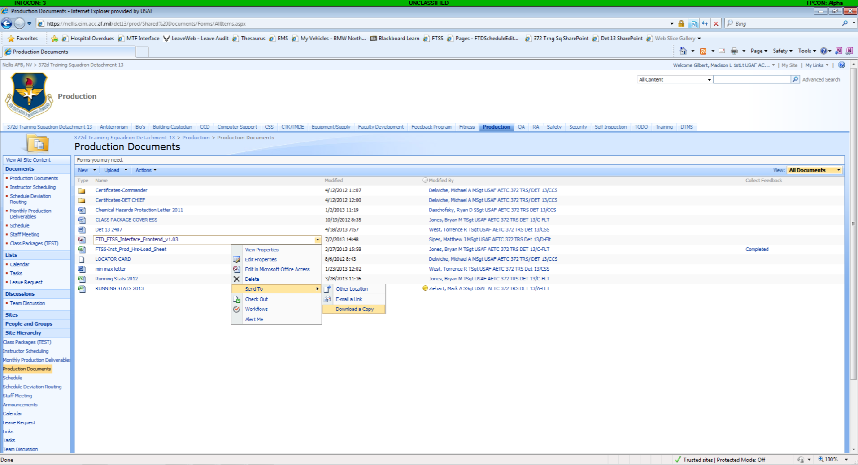
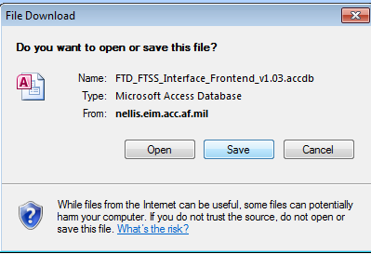
Users: Interface Setup
The Frontend may be located on the Det’s SharePoint or Shared Drive and will be determined by the Det’s Database Manager. ProSupers/Leadership/ Schedulers should save a copy on their Desktop for easy accessibility.

Slide 30
Users: Interface Setup
As shown in the previous slide, ask for the shared link location to your detachment’s Frontend Interface. Your database manager will know the location of the interface. Save a copy of the icon to your desktop. Start to use by double clicking icon.
(Computer Desktop)
1. Save a copy of the Frontend (link given by detachment Database Manager) and double click to use.
THIS IS THE END OF THE USER INSTALLATION PROCESS

Slide 31
Users: User Functions
3. User Functions
To be accomplished by all Users
ALL USERS INPUT THEIR HOURS

Slide 32
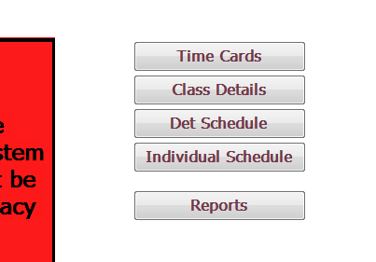
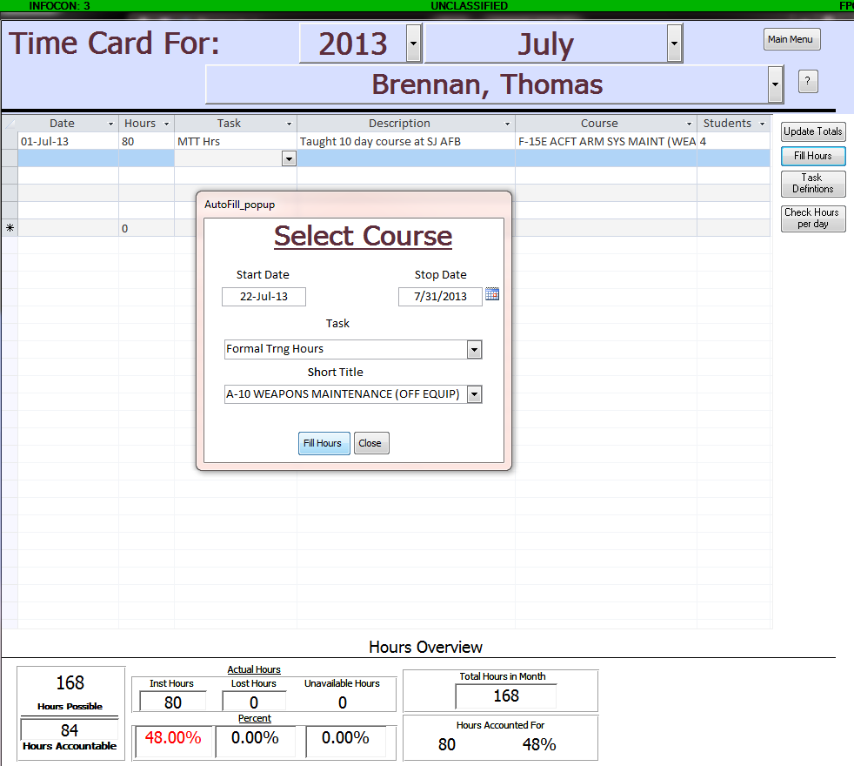
Users: Time Cards
Click on the “Time Cards” button on the right-hand side of the Main Menu. .
Select that appropriate year, month, and instructor name at the top. Then fill out the time card like an excel spreadsheet, or click the “Fill Hours” button on the right to select a start/stop date, task, and course.

Slide 33
Users: Time Cards
For definitions of tasks, click the “Task Definition” button. This enables the user to view what counts toward the detachment’s utilization, as well as what reduces the amount of available hours in a month. Once you have completed your time card, press “Update Totals” and review the Hours Overview displayed at the bottom for accuracy before exiting. Exit by clicking the “Main Menu” button at the top right.

Slide 34
Users: Class Details
The Class Details button shows ongoing and upcoming classes so that you can fill out a student roster. This assists in production metrics because the students ranks are tallied up for OP, CP, and AP. You can also make a recall roster for the class too.

Slide 35
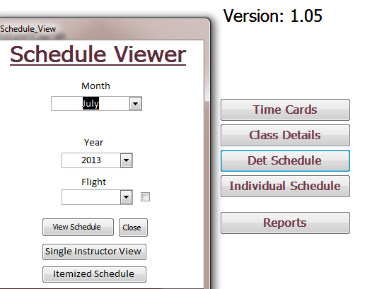
Users: View Det Schedule
Click the “Det Schedule” button on the right-hand side of the main menu to open the detachment’s schedule, an instructor’s schedule, or an itemized schedule. Examples of each can be found on the next slide.

Slide 36
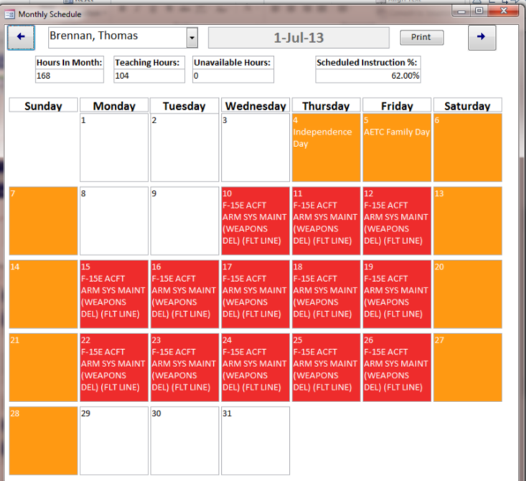
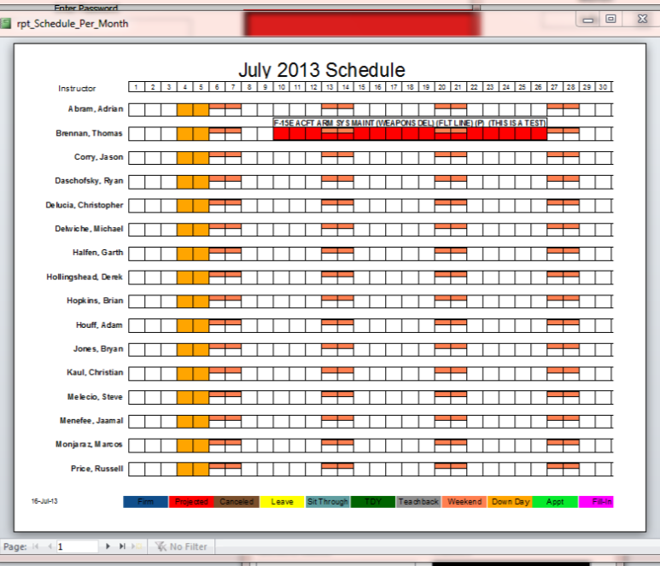
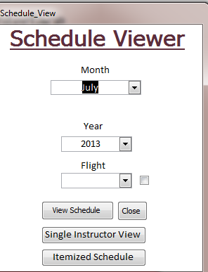
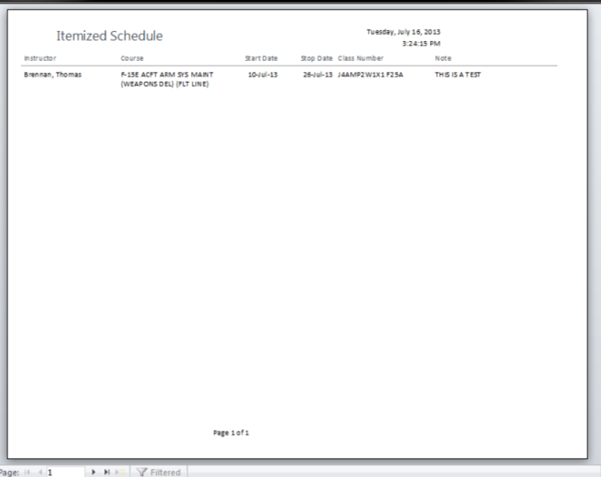
Users: View Det Schedule

Slide 37
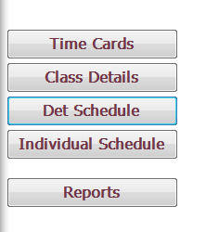
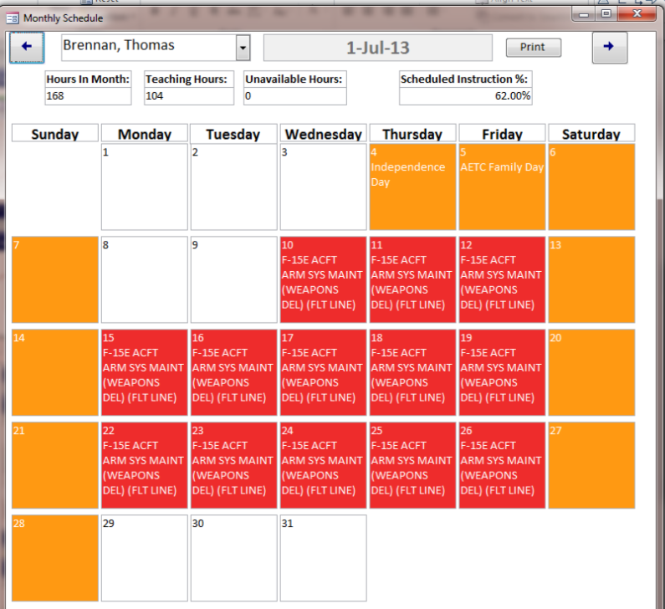
Users: View Individual Schedule
You can view the individual schedule either by clicking Det Schedule then selecting the “Single Instructor View” button, or simply by clicking the “Individual Schedule” button.

Slide 38
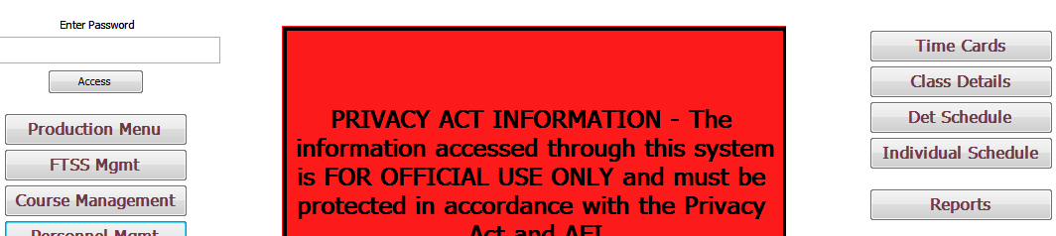
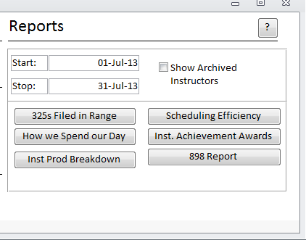
Users: View Reports
The FTD Interface offers several reports for the user. These reports can be opened either by clicking the “Reports” button, or by clicking the “Production Menu” button.
How We Spend Our Day Report shows Instructor Hours broken down by formal, MTT, Leave, etc.
Form 898 Report with Course, CAMS & PDS code, Min/Max, CAF/MCL, Backlog, MTF Seats Available, FTD seats available, FTD seats unused, and remarks for the 3 months.

Slide 39
Schedulers: 898 Requests
3. Responding to 898 Requests
Schedulers should accomplish all tasks given to Users, as well as the following.
SCHEDULERS

Slide 40
Schedulers: 898 Requests
(Computer Desktop)
Click on the FTD FTSS Interface Frontend icon on your desktop. When the Interface opens, acknowledge the Privacy Act Information statement.

Slide 41
Schedulers: 898 Requests
To respond to 898 requests made by MTFs, click the Production Menu button.
NOTE: If the Production menu does not show on the left-hand side, request the password from your Database Manager. The default password is “DET”. Input the password to view the Production Menu.

Slide 42
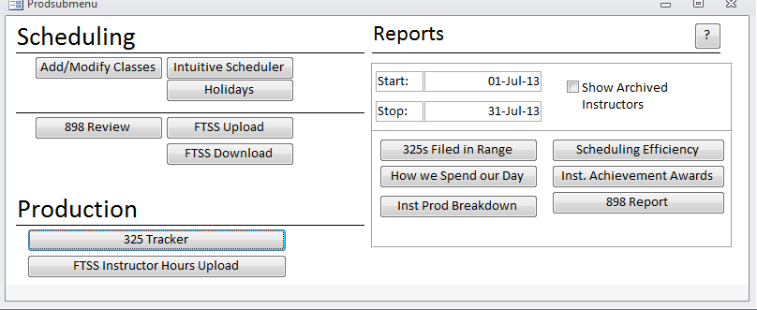
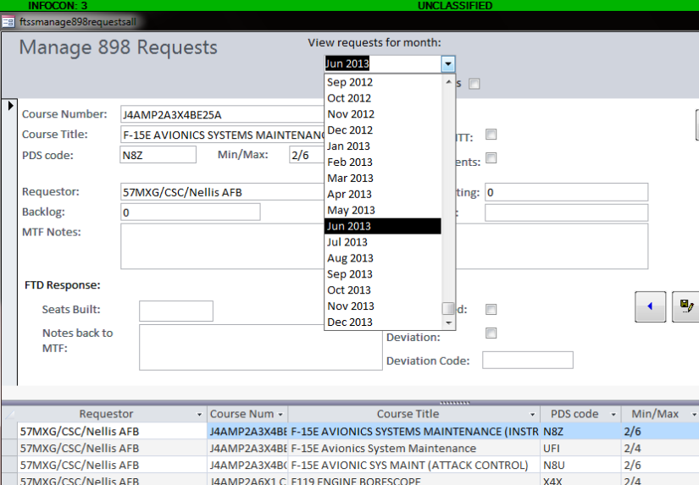
Schedulers: 898 Requests
To respond to 898 requests made by MTFs, click the “898 Review” button.
Select the applicable month for the requests. Next, respond to the requests by inputting the number of seats built, notes back to MTF, whether you addressed their request, and any deviations. This must be done for each row (request).

Slide 43
Schedulers: Additional Functions
3. Additional Functions
Schedulers should accomplish all tasks given to Users, as well as the following.
THESE FEATURES EXPLAIN HOW TO REQUEST TTMS NUMBERS FOR CLASSES, SCHEDULE CLASSES, ETC.

Slide 44
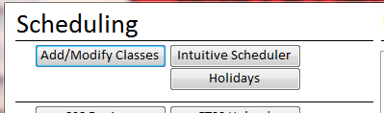
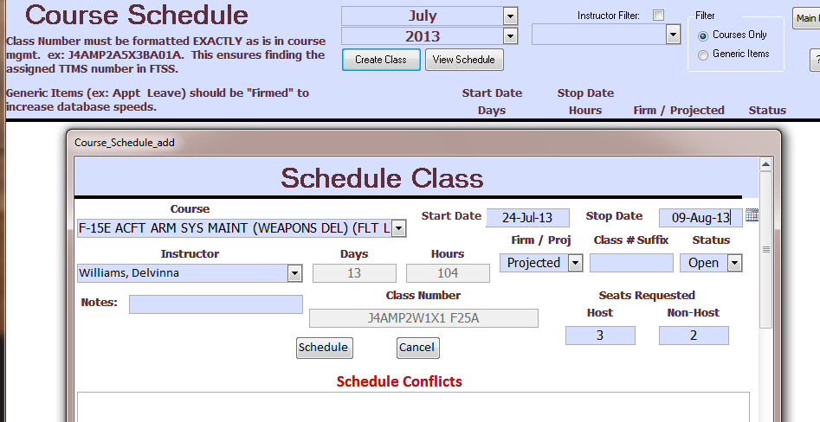
Schedulers: Creating Classes/Schedule
To create an instructor schedule, you can click the “Add/Modify Classes” button under the Production Menu.
NOTE: THERE ARE TWO WAYS TO SCHEDULE CLASSES—SEE NEXT SLIDE FOR ALTERNATE OPTION.
Choose the month/year you would like to schedule and click the “Create Class” Button.
Input the course to be taught (or leave/appt/etc), the instructor, the start date, whether it is firm or projected, how many host/non-host, and any notes; then press “Schedule”.

Slide 45
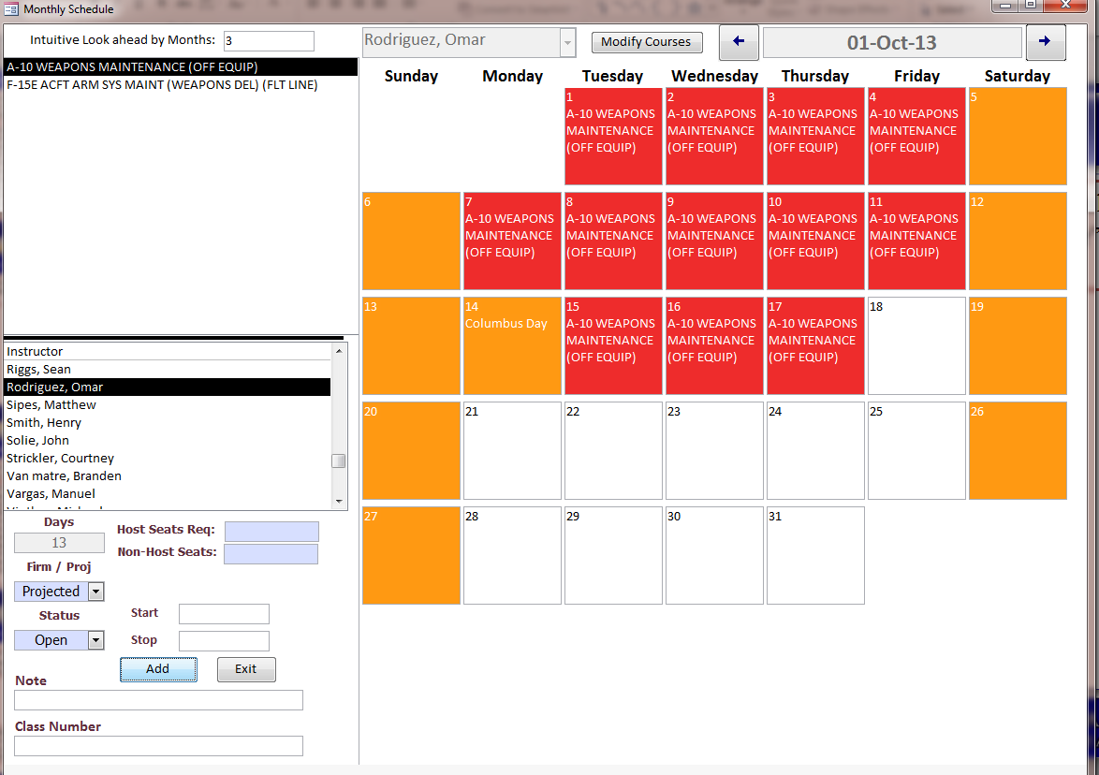
Schedulers: Creating Classes/Schedule
To create an instructor schedule, you can click the “Intuitive Scheduler” button under the Production Menu.
NOTE: THERE ARE TWO WAYS TO SCHEDULE CLASSES—SEE PREVIOUS SLIDE FOR ALTERNATE OPTION.
Click on the course needed and the instructor teaching it (or the leave, appt, etc.) Input the appropriate dates/ seats requested, and click “Add”. The schedule will then show on the calendar/will save.

Slide 46
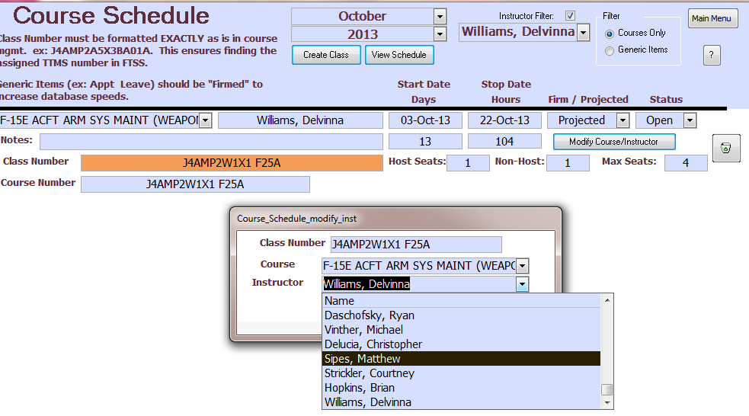
Schedulers: Delete/Modify Instr Schedule
To delete or modify an input in the schedule, click the “Add/Modify Classes” button.
Select the desired Month, Year, and Instructor under the Instructor Filter. Check the Box to the right of Instructor Filter. You can now view all classes assigned to that instructor for that month/year. Click “Modify Course/Instructor” to change the instructor teaching the class or the course taught. Click on the Trashcan button to delete the class.

Slide 47
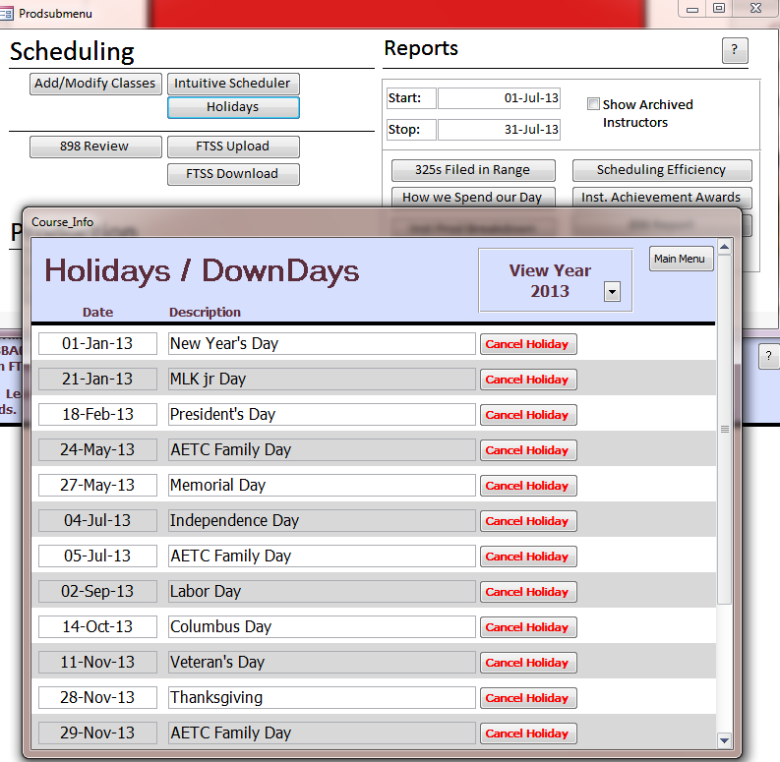
Schedulers: Holidays
To alter holidays that show on the instructors’ schedules, click the “Holidays” button under Production Menu. Class days will automatically schedule around holidays and weekends. You can click “Cancel Holiday” to allow classes to be scheduled on the holiday, and you can add additional holidays at the bottom of this page.

Slide 48
Schedulers: TTMS Numbers
After creating the monthly schedule, use the “FTSS Upload” button to input all the classes into FTSS so that the schedulers at Sheppard can assign each class a TTMS class number
After giving the Sheppard scheduler a few days, the TTMS class numbers can be downloaded back to the interface by clicking the “FTSS Download” button.

Slide 49
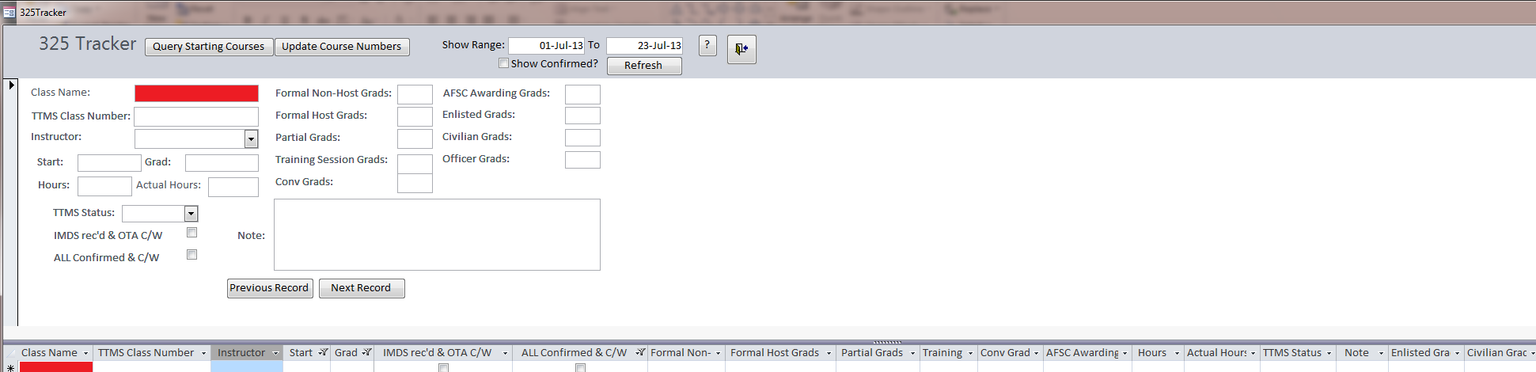
Schedulers: 325 Tracker
The 325 Tracker pulls courses starting in the next few weeks when you click the “Query Starting Courses” button. The “IMDS received & OTA complied with” box can be accomplished and checked before classes start. Once the instructor has completed teaching the course, you can click “Update Course Numbers” to pull information from the time cards and class details function on the main menu. NOTE: Ensure you input the ranks of students under class details so that the students will be properly annotated as OP, AP, or CP.

Slide 50
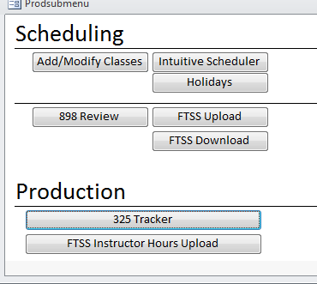
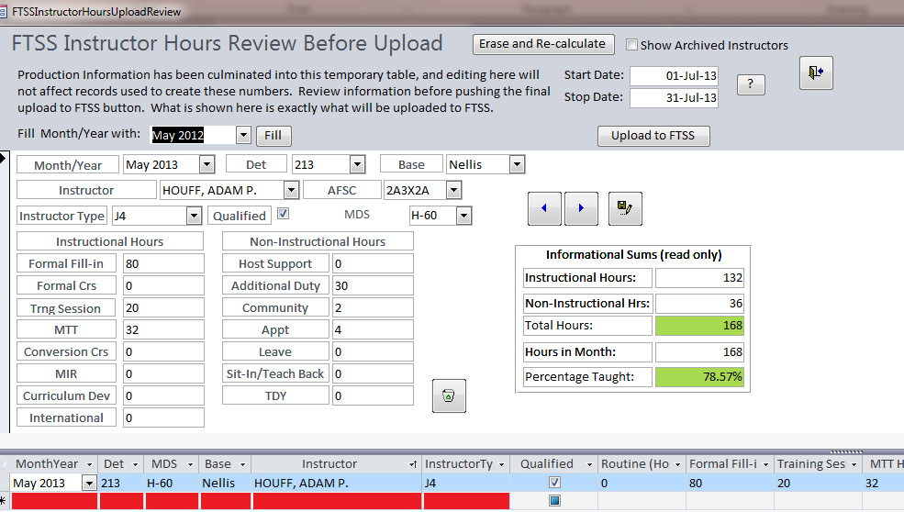
Schedulers: FTSS Instr Hours Upload
Click the “FTSS Instructor Hours Upload” button to upload all instructor hours/TDY/Leave/etc. to FTSS at the end of the month.
NOTE: ProSupers/Schedulers need to upload this each month. This will eventually replace the Monthly Production Stats sent to the Sq/uploaded to Sharepoint.
Input each Instructor Hours each month. You can automatically fill Month/Year by selecting Month/Year at top. All hours should add up to the Hours in Month. If you need to erase one instructor’s information, click the trash can button. Once you have inputted all information, click “Upload to FTSS”.

Slide 51
Summary
Summary
Access
Initial Programming
Initial Programming
User Functions
Electronic 898 Responses
Additional Features
Summary/Contact Information
Questions? Suggestions on ways to make this instructional guide or FTD FTSS Interface better for those using it in the future?
Please do not hesitate to email/call: Capt Gilbert (madison.gilbert.1@us.af.mil) at DSN 682-8150 or SSgt Pratt (cody.pratt@ellsworth.af.mil) at DSN 675-2318.

